Slide 1
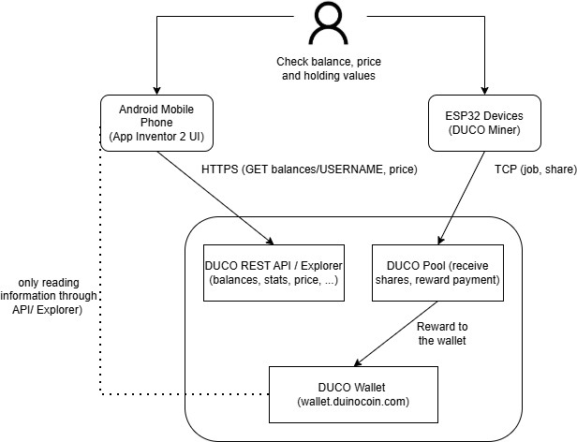
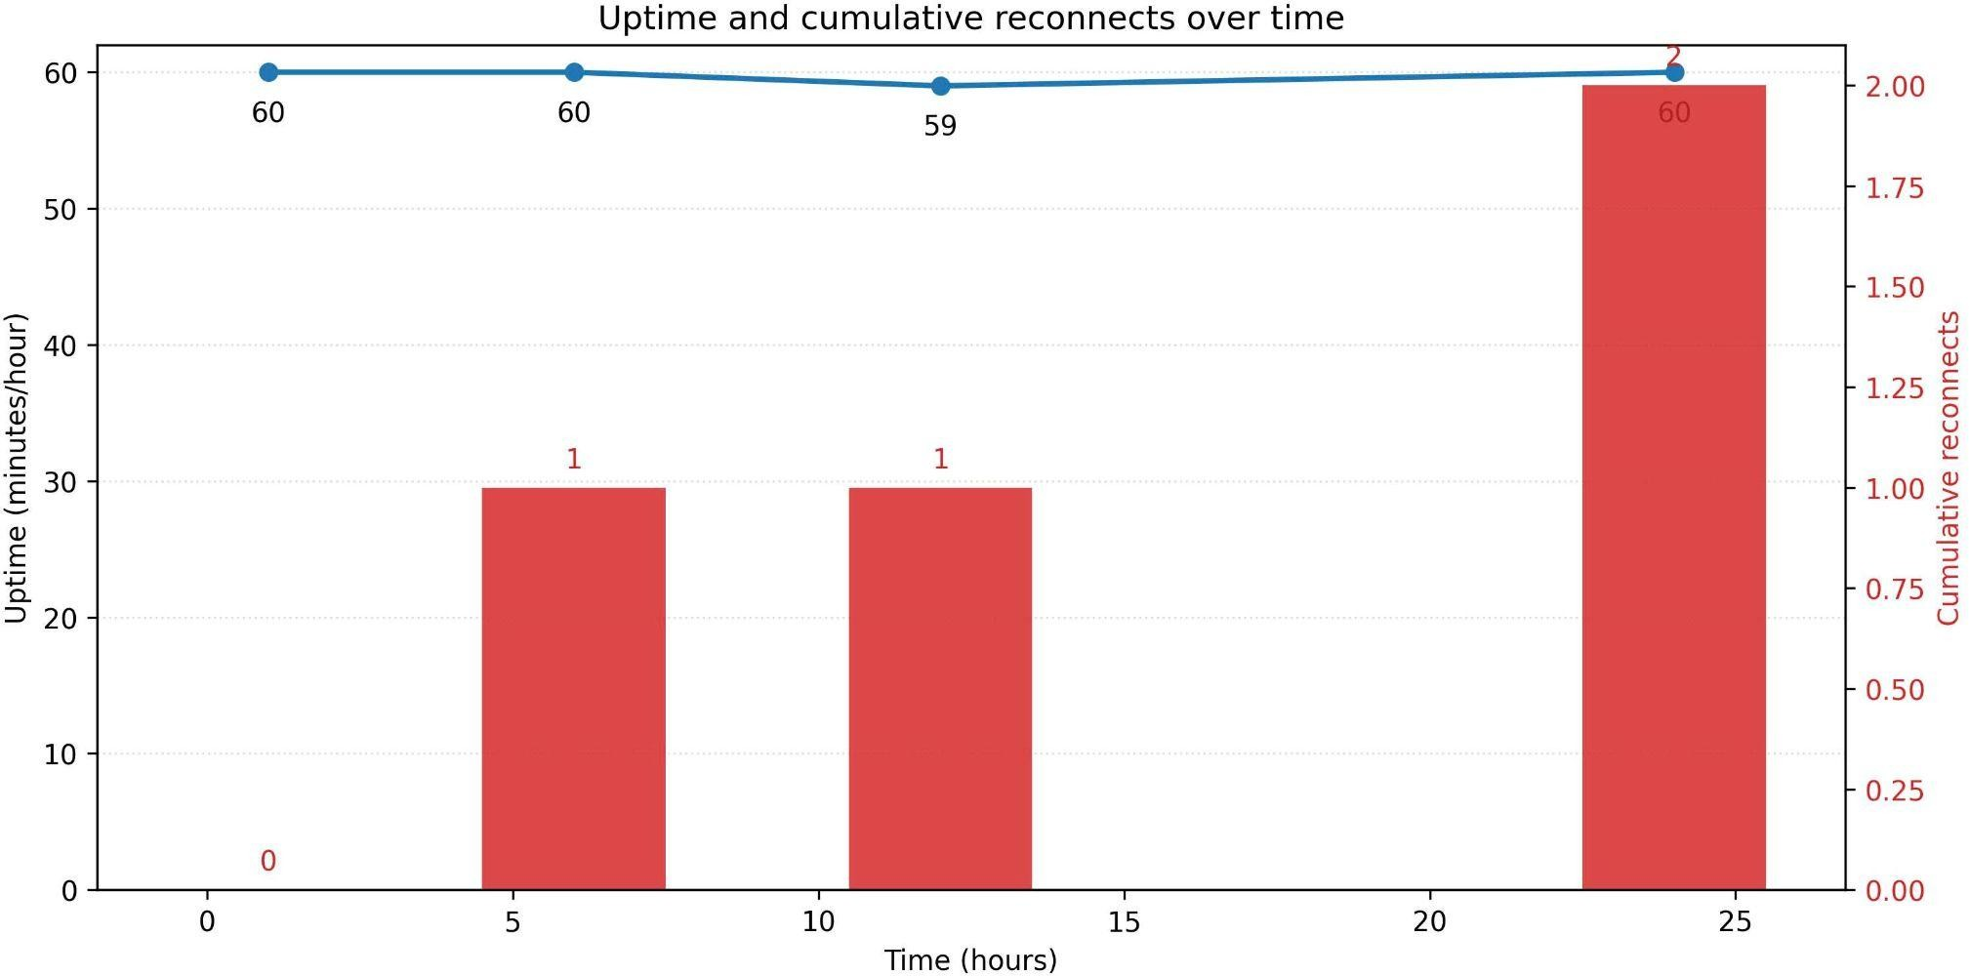

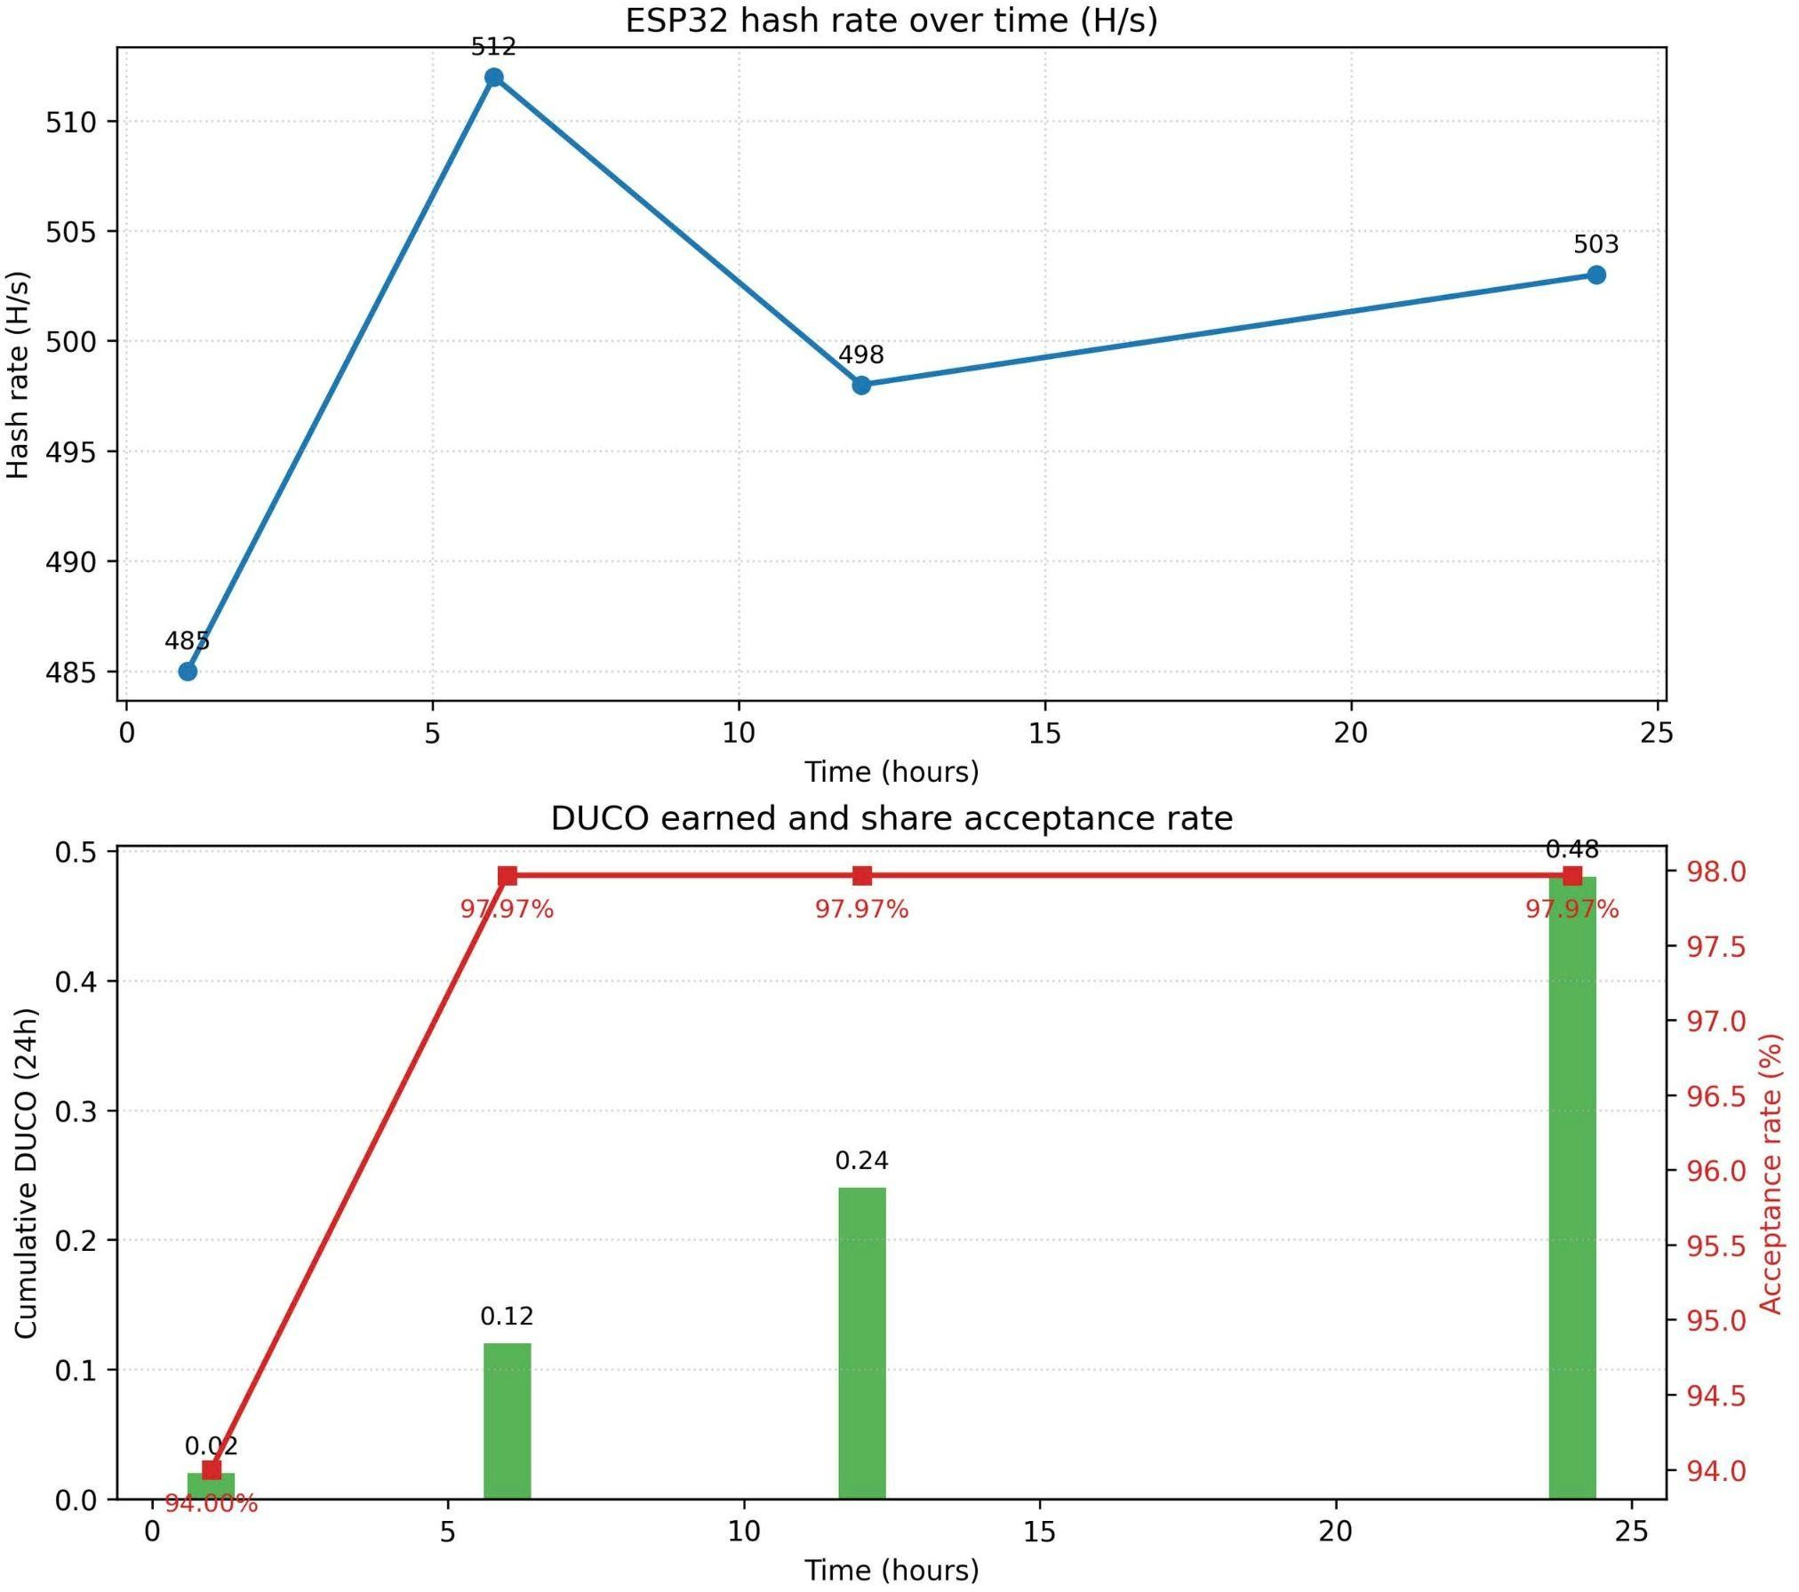
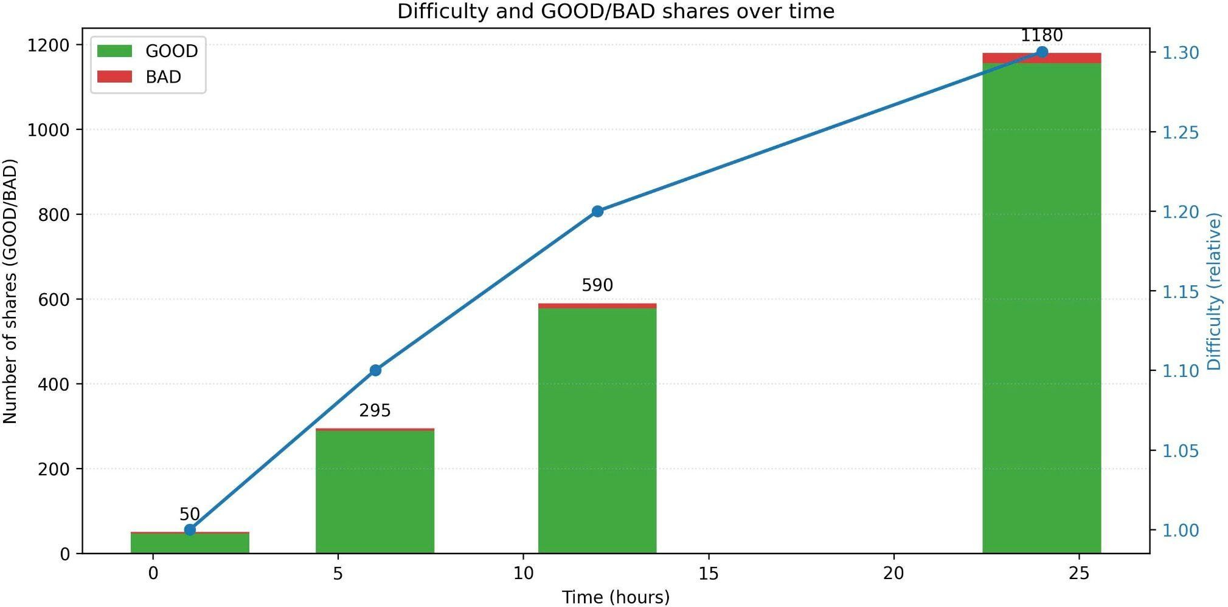
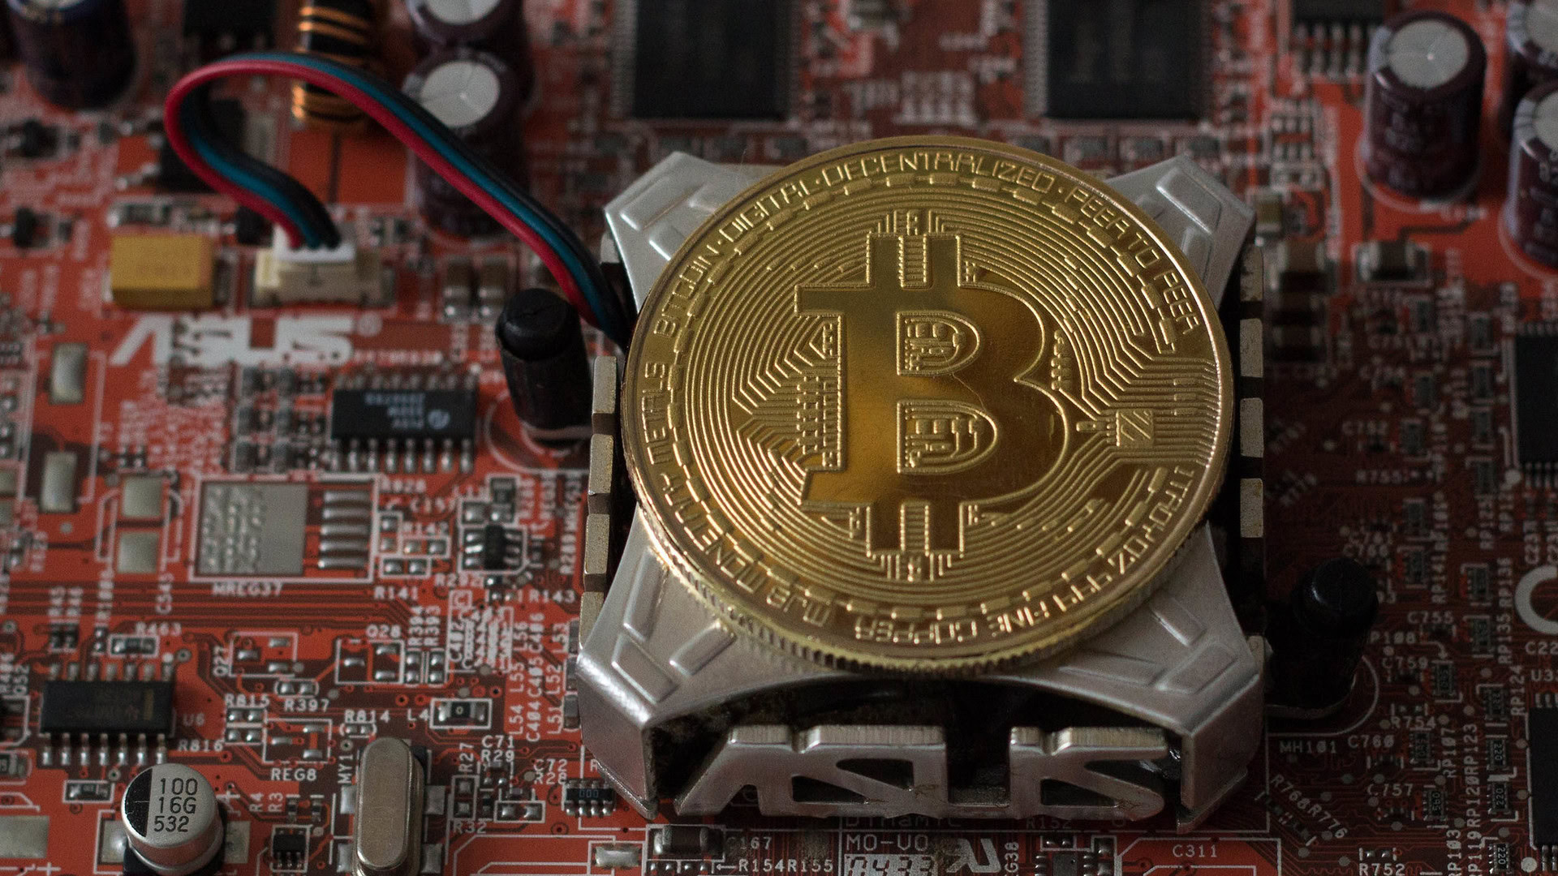
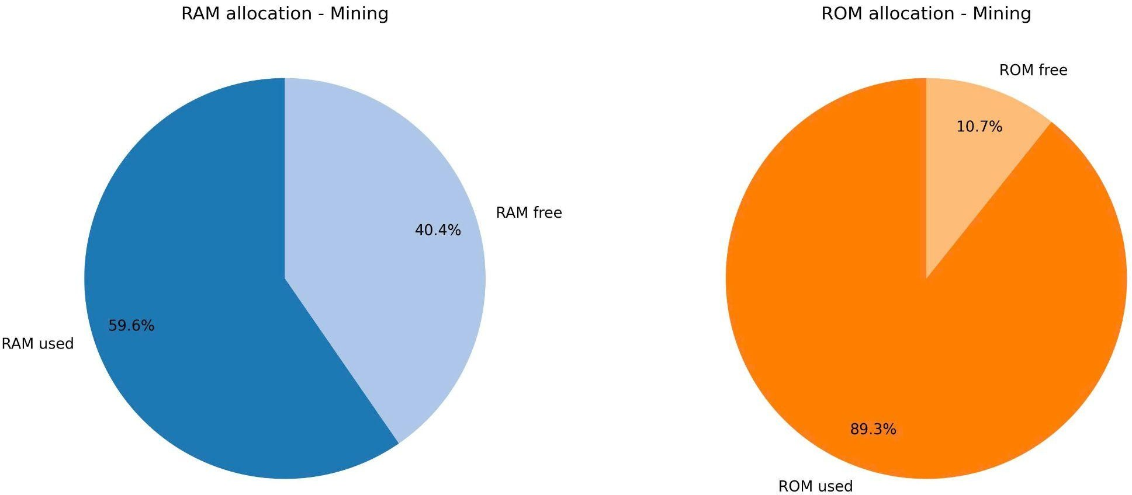
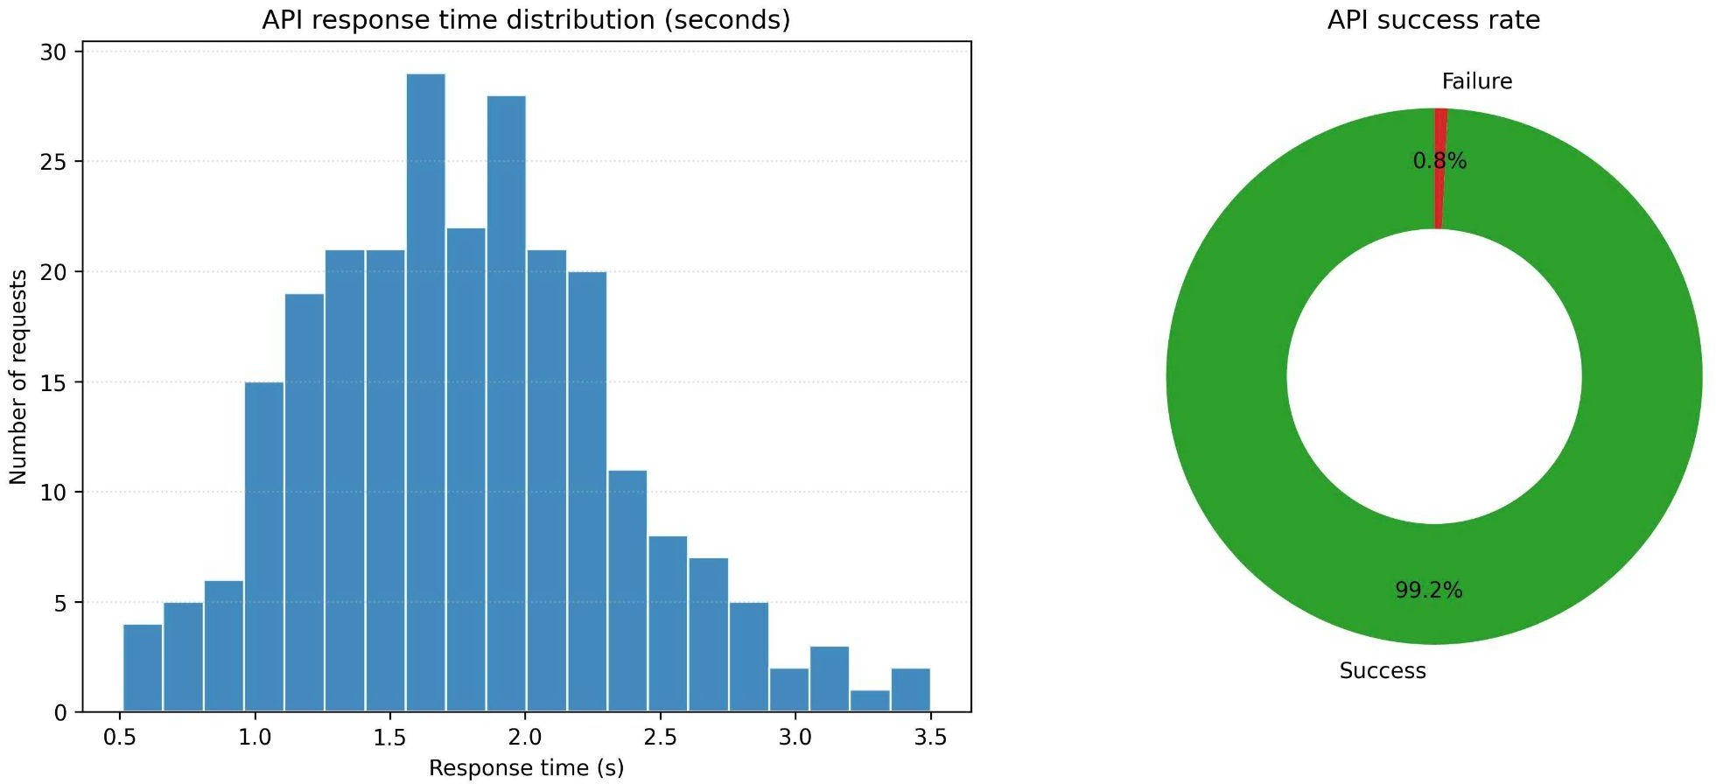
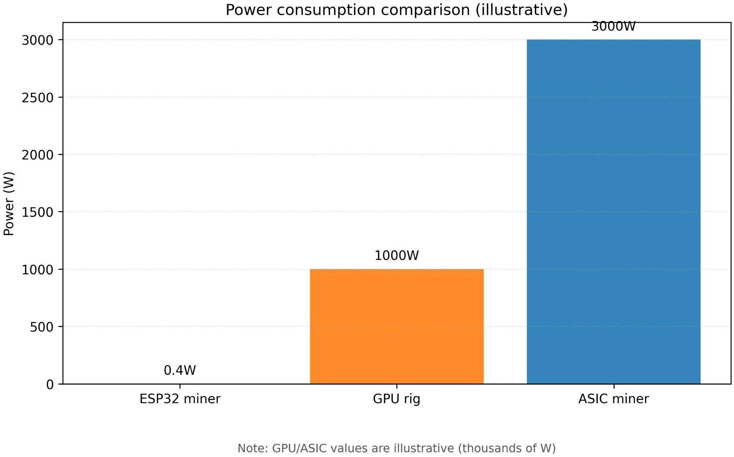
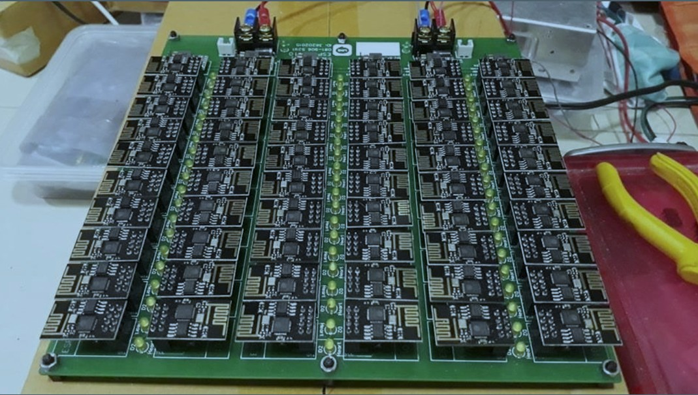
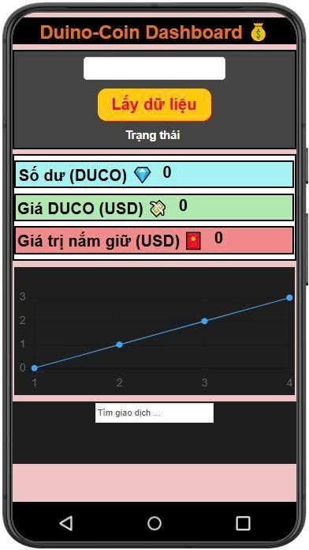
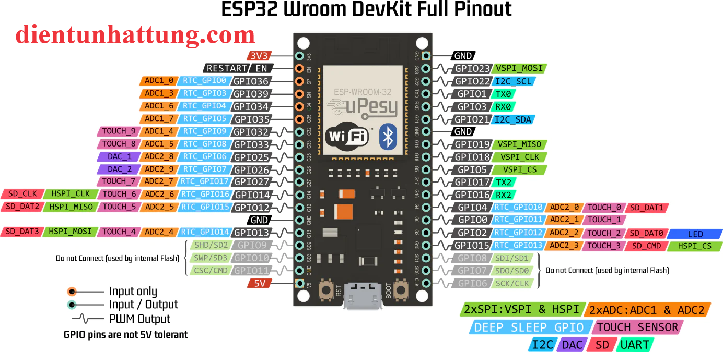


Project: Duino-Coin Mining System
Author: Thanh Tung
I. Idea
III. System Architecture
V. Result
Low-cost educational cryptocurrency miner.
ESP32 performs SHA-1 mining.
Mobile app monitors wallet, balance, exchange rate
ESP32 Miner ↔ DUCO Server via TCP
App Inventor App ↔ REST API
Real-time monitoring + low power
503 H/s average hash rate
97.97% accepted shares
0.4W ultra-low power
99.2% API success rate
II. Objectives
IV. Components
Build fully functional ESP32 DUCO miner.
Develop App Inventor monitoring app.
Evaluate performance, power, and stability.
ESP32-WROOM-32
WiFi TCP mining engine
DUCO REST API interface
Android App (App Inventor 2)
VI. Innovation
Educational blockchain system
Extremely low energy mining
App-based monitoring & automation
Expandable for multi-miner management

